Slide 1

YOKOHAMA RACE HISTORY
Elite Analysis · Past 8 Years · April 2026
USA Triathlon High Performance

Slide 2
ELITE MEN ♂

Slide 3
Race Overview — Elite Men
Yokohama
Year | Date | Category | Field | Winner | Winner Time | Air Temp | Water Temp | Swim km | Bike km | Run km
2018 | May 12 | World Championship Series | 48 | Mola | 1:44:59 | 20.1 | — | — | — | —
2019 | May 18 | World Championship Series | 45 | Luis | 1:43:21 | 19.7 | — | — | — | —
2021 | May 15 | World Championship Series | 48 | Blummenfelt | 1:42:55 | 22.1 | — | — | — | —
2022 | May 14 | World Championship Series * | 45 | Yee | 1:43:30 | 22.0 | — | 1.50 | 40.0 | 10.0
2023 | May 13 | World Championship Series * | 49 | Wilde | 1:42:13 | 17.1 | — | 1.50 | 40.0 | 10.0
2024 | May 11 | World Championship Series | 47 | Pearson | 1:42:05 | 20.9 | — | 1.50 | 40.0 | 10.0
2025 | May 17 | World Championship Series * | 42 | Hauser | 1:41:08 | 21.6 | 20.1 | 1.50 | 37.2 | 10.0
* Course distance changed vs. prior year

Slide 4
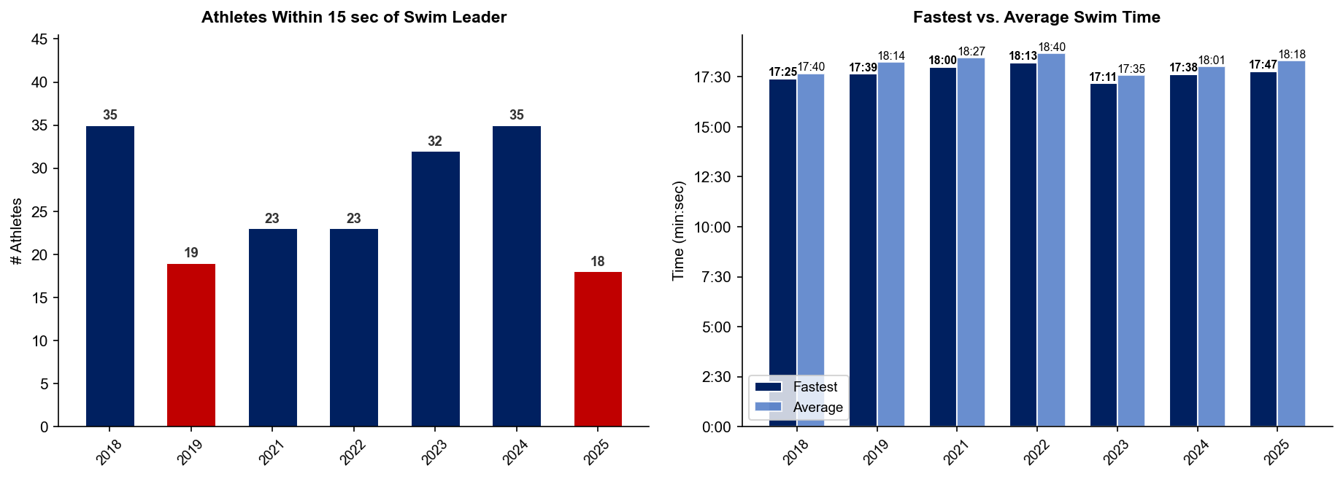
Swim Exit Dynamics — Elite Men
Yokohama

Slide 5
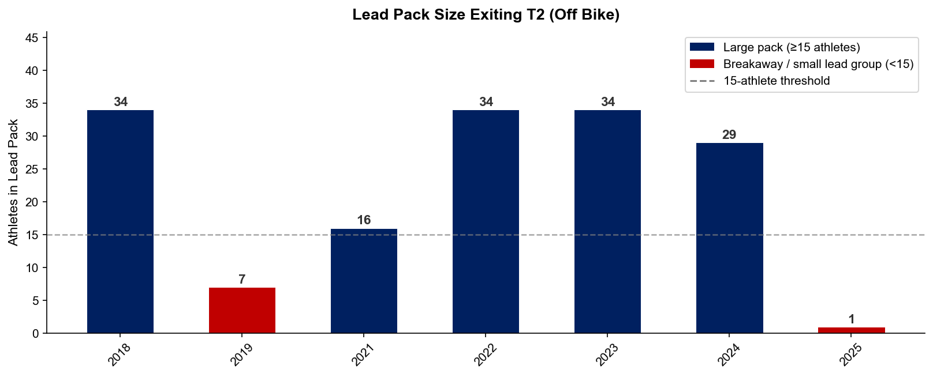
Bike Pack Dynamics — Elite Men
Yokohama

Slide 6
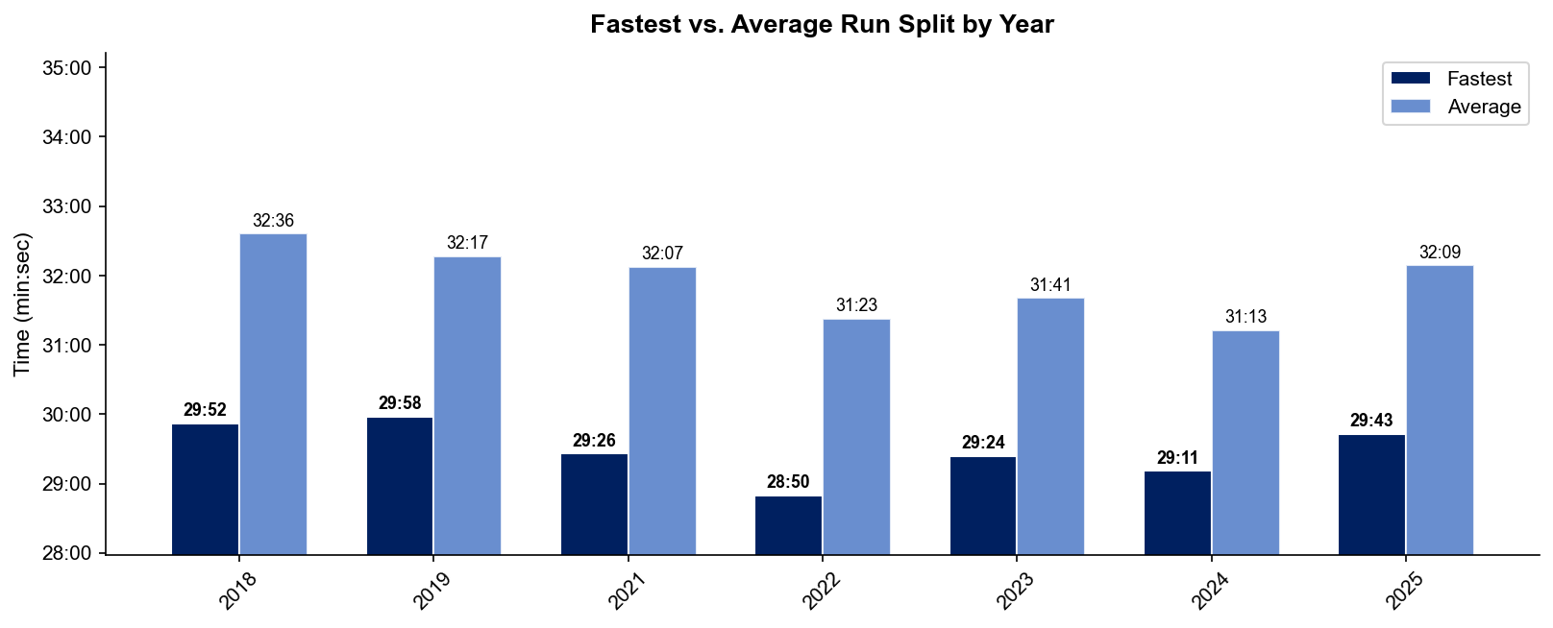
Run Split Analysis — Elite Men
Yokohama

Slide 7
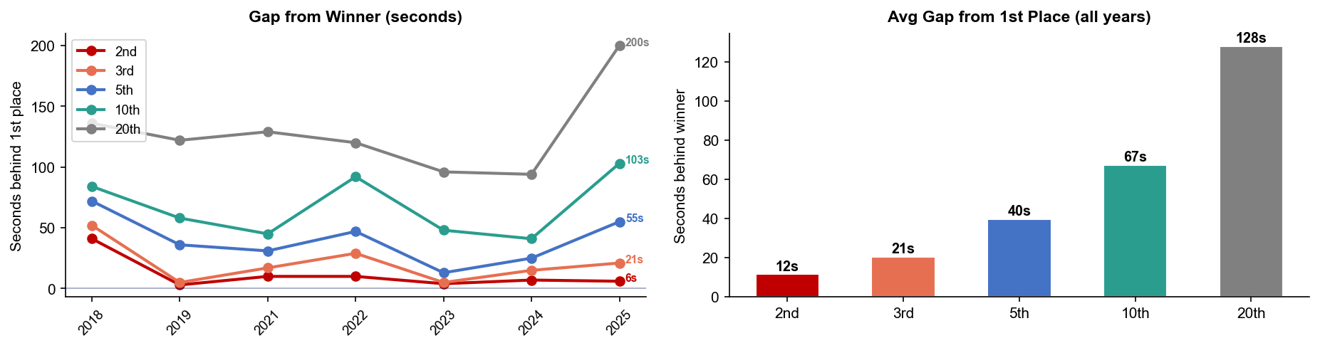
Key Position Times — Elite Men
Yokohama
Year | 1st | 2nd | 3rd | 5th | 10th | 20th
2018 | 1:44:59 | 1:45:40 +41s | 1:45:51 +52s | 1:46:11 +72s | 1:46:23 +84s | 1:47:15 +136s
2019 | 1:43:21 | 1:43:24 +3s | 1:43:26 +5s | 1:43:57 +36s | 1:44:19 +58s | 1:45:23 +122s
2021 | 1:42:55 | 1:43:05 +10s | 1:43:12 +17s | 1:43:26 +31s | 1:43:40 +45s | 1:45:04 +129s
2022 | 1:43:30 | 1:43:40 +10s | 1:43:59 +29s | 1:44:17 +47s | 1:45:02 +92s | 1:45:30 +120s
2023 | 1:42:13 | 1:42:17 +4s | 1:42:18 +5s | 1:42:26 +13s | 1:43:01 +48s | 1:43:49 +96s
2024 | 1:42:05 | 1:42:12 +7s | 1:42:20 +15s | 1:42:30 +25s | 1:42:46 +41s | 1:43:39 +94s
2025 | 1:41:08 | 1:41:14 +6s | 1:41:29 +21s | 1:42:03 +55s | 1:42:51 +103s | 1:44:28 +200s

Slide 8
Race Conditions — Elite Men
Yokohama
Year | Date | Air Temp | Water Temp | Wind (km/h) | Wetsuit | Conditions
2018 | May 12 | 20.1 | — | 9 | — | —
2019 | May 18 | 19.7 | — | 21 | — | —
2021 | May 15 | 22.1 | — | 6 | — | —
2022 | May 14 | 22.0 | — | 15 | — | —
2023 | May 13 | 17.1 | — | 12 | — | —
2024 | May 11 | 20.9 | — | 28 | — | —
2025 | May 17 | 21.6 | 20.1 | 23 | — | —

Slide 9
ELITE WOMEN ♀

Slide 10
Race Overview — Elite Women
Yokohama
Year | Date | Category | Field | Winner | Winner Time | Air Temp | Water Temp | Swim km | Bike km | Run km
2018 | May 12 | World Championship Series | 46 | Duffy | 1:53:26 | 20.1 | — | — | — | —
2019 | May 18 | World Championship Series | 39 | Zaferes | 1:52:12 | 19.7 | — | — | — | —
2021 | May 15 | World Championship Series | 49 | Knibb | 1:54:27 | 22.1 | — | — | — | —
2022 | May 14 | World Championship Series * | 33 | Taylor-Brown | 1:51:44 | 22.0 | — | 1.50 | 40.0 | 10.0
2023 | May 13 | World Championship Series * | 52 | Coldwell | 1:53:32 | 17.1 | — | 1.50 | 40.0 | 10.0
2024 | May 11 | World Championship Series | 55 | Periault | 1:52:28 | 25.4 | 19.8 | 1.50 | 40.0 | 10.0
2025 | May 17 | World Championship Series * | 40 | Lehair | 1:51:34 | 19.8 | 20.2 | 1.50 | 37.2 | 10.0
* Course distance changed vs. prior year

Slide 11
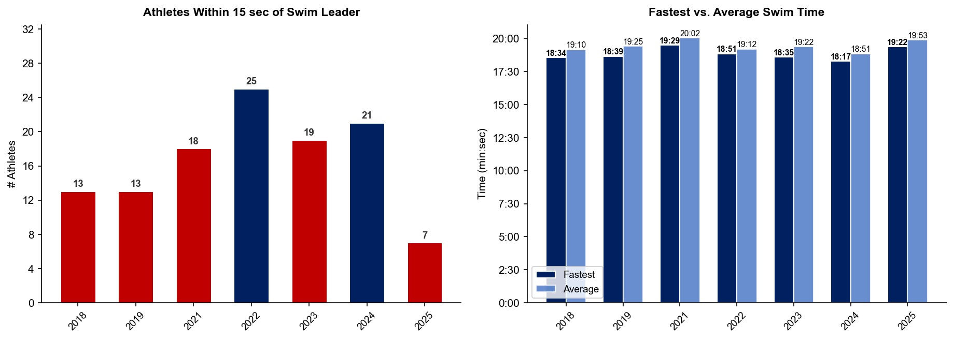
Swim Exit Dynamics — Elite Women
Yokohama

Slide 12
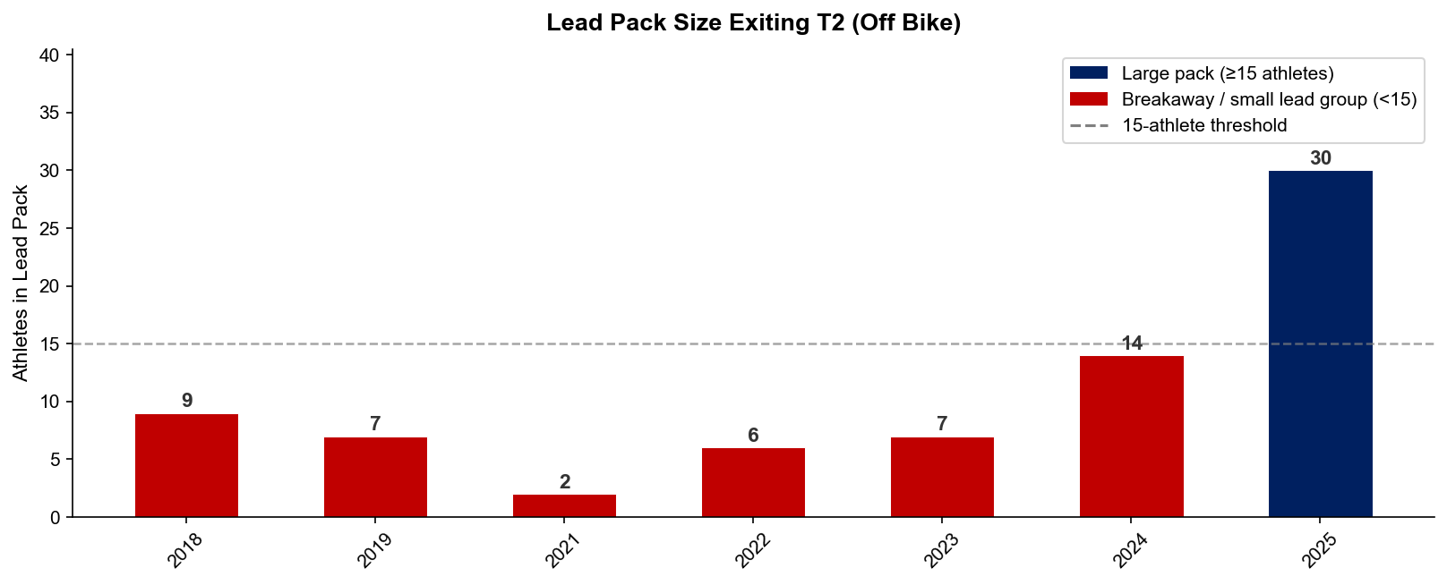
Bike Pack Dynamics — Elite Women
Yokohama

Slide 13
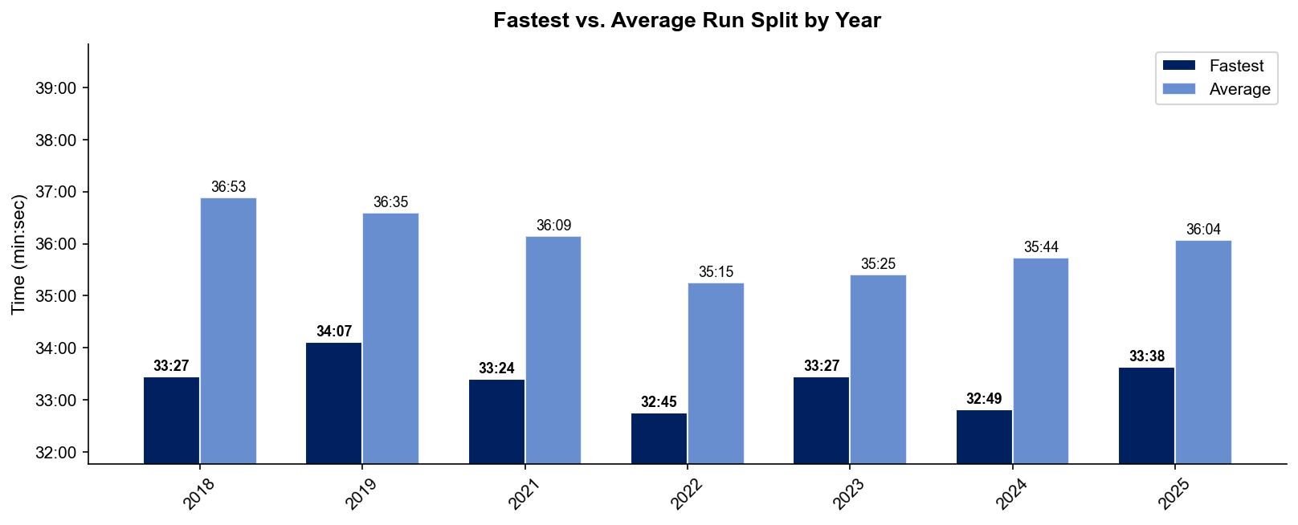
Run Split Analysis — Elite Women
Yokohama

Slide 14
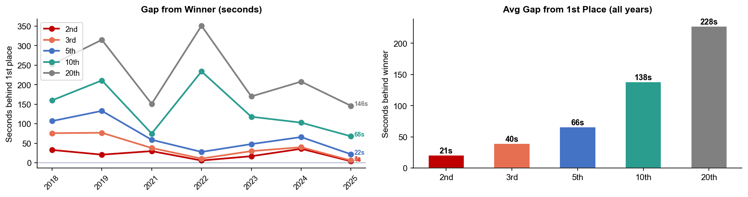
Key Position Times — Elite Women
Yokohama
Year | 1st | 2nd | 3rd | 5th | 10th | 20th
2018 | 1:53:26 | 1:53:59 +33s | 1:54:42 +76s | 1:55:13 +107s | 1:56:06 +160s | 1:57:38 +252s
2019 | 1:52:12 | 1:52:33 +21s | 1:53:29 +77s | 1:54:25 +133s | 1:55:43 +211s | 1:57:27 +315s
2021 | 1:54:27 | 1:54:57 +30s | 1:55:05 +38s | 1:55:26 +59s | 1:55:42 +75s | 1:56:58 +151s
2022 | 1:51:44 | 1:51:50 +6s | 1:51:55 +11s | 1:52:12 +28s | 1:55:38 +234s | 1:57:35 +351s
2023 | 1:53:32 | 1:53:49 +17s | 1:54:02 +30s | 1:54:20 +48s | 1:55:30 +118s | 1:56:22 +170s
2024 | 1:52:28 | 1:53:04 +36s | 1:53:08 +40s | 1:53:34 +66s | 1:54:11 +103s | 1:55:56 +208s
2025 | 1:51:34 | 1:51:38 +4s | 1:51:40 +6s | 1:51:56 +22s | 1:52:42 +68s | 1:54:00 +146s

Slide 15
Race Conditions — Elite Women
Yokohama
Year | Date | Air Temp | Water Temp | Wind (km/h) | Wetsuit | Conditions
2018 | May 12 | 20.1 | — | 9 | — | —
2019 | May 18 | 19.7 | — | 21 | — | —
2021 | May 15 | 22.1 | — | 6 | — | —
2022 | May 14 | 22.0 | — | 15 | — | —
2023 | May 13 | 17.1 | — | 12 | — | —
2024 | May 11 | 25.4 | 19.8 | 28 | allowed | —
2025 | May 17 | 19.8 | 20.2 | 23 | forbidden | —

